Slide 1
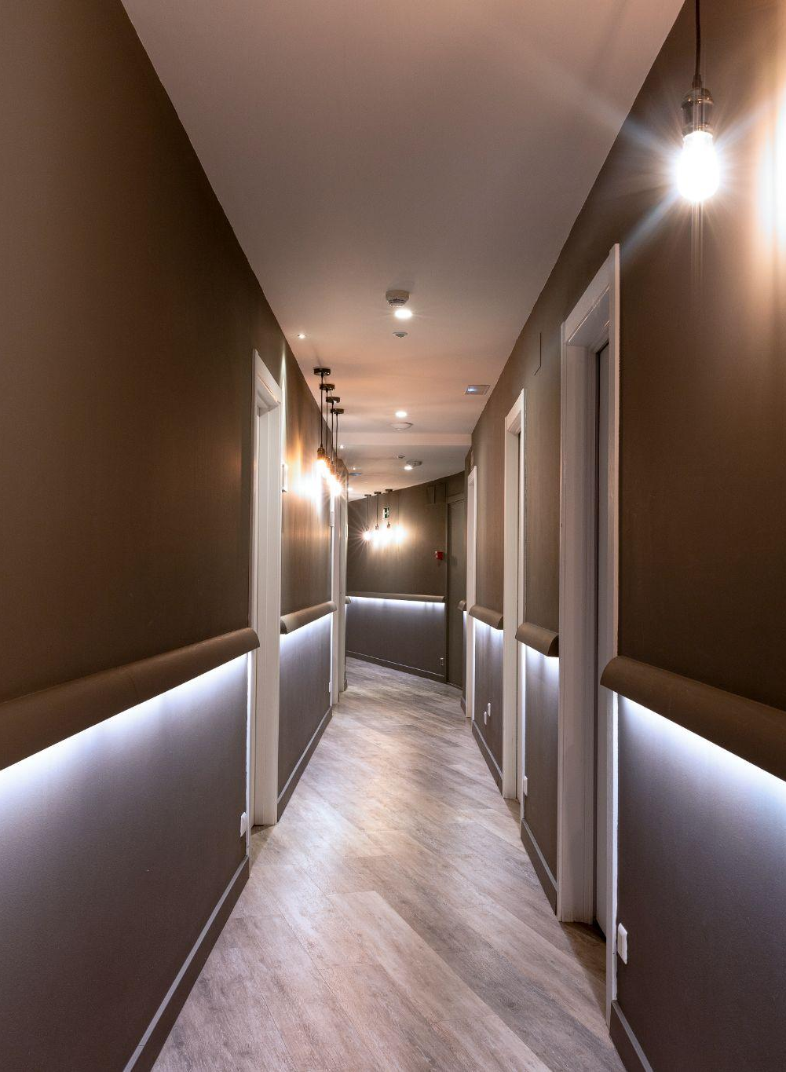
JAVA INDIVIDUAL PROJECT (HOTEL MANAGEMENT SYSTEM)
2023
PREPARED BY :
NAME : GOHEL HARDIK
ROLL NO. :206
DIV :7
ENROLL : 22002170110036
HOTEL MANAGEMENT SYSTEM
HOTEL
PROJECT

Slide 2
MAIN OBJECTIVES OF THE PROJECT
2023
Effortless Check-In: "Streamlined check-in for a swift arrival experience."
Seamless Check-Out: "Hassle-free check-out, right from your room."
Real-time Room Availability: "Instantly know which rooms are ready to welcome you."
Occupancy Status at a Glance: "Stay informed with real-time room occupancy updates."
Effortless Exit: "Bid farewell with ease and fond memories."
HOTEL MANAGEMENT SYSTEM
PROJECT

Slide 3
FUNCTIONS
2023
01
02
03
04
HOTEL MANAGEMENT SYSTEM
CHECK-IN
CHECK-OUT
AVAILABLE ROOMS
OCCUPIED ROOMS
PROJECT

Slide 4

INTRODUCTION
2023
2023
HOTEL MANAGEMENT SYSTEM
HOTEL MANAGEMENT SYSTEM
PROJECT
PROJECT

Slide 5
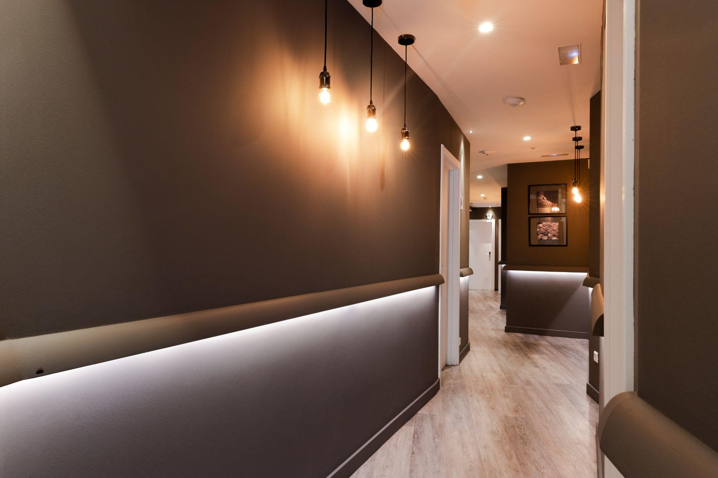
—Introduction
"Welcome to our Hotel Management System project powered by Java, where modern technology meets hospitality. With seamless room booking, check-in, and check-out processes, we're here to revolutionize your hotel experience."
2023
HOTELROOM
HOTEL MANAGEMENT SYSTEM
PROJECT

Slide 6

SECTION 1
01
2023
ROOM CHECK IN
At our hotel, we prioritize your comfort and convenience right from the moment you step through our doors. Our efficient check-in process ensures a smooth and swift arrival. We collect essential details like your name, ID, and mobile number, safeguarding them in a secure array. Through the power of JDBC, your information is seamlessly stored in our database, guaranteeing a safe and effortless start to your stay. Welcome to a world where your needs are not just met, but exceeded.
HOTEL MANAGEMENT SYSTEM
PROJECT
HOTEL

Slide 7

SECTION 2
02
2022
ROOM CHECK-OUT
When it's time to bid adieu, our streamlined check-out process ensures your farewell is as pleasant as your stay. We calculate your bill based on the number of days you've enjoyed and the room type you selected. Your detailed billing statement is generated with precision, and a record is securely stored in a text file, labeled with your room number. We believe in making every aspect of your departure hassle-free, leaving you with fond memories of your stay.
HOTEL
HOTEL MANAGEMENT
VIEWS
BUSINESS

Slide 8

03
SECTION 3
2022
VIEW AVAILABLE ROOMS AND OCCUPIED ROOMS
VIEW
Planning your stay has never been easier. With our Hotel Management System, you can effortlessly view both available and occupied rooms in real-time. Find your ideal sanctuary among the available options or gain insight into the heartbeat of our hotel by checking the occupied rooms.
HOTEL
HOTEL MANAGEMENT
VIEWS
BUSINESS

Slide 9
04
EXIT
2023
RELAX
HOTEL MANAGEMENT SYSTEM
PROJECT

Slide 10


THANKS!
THANKS!
2023
PROJECT
HOTEL MANAGEMENT SYSTEM
PROJECT

